Slide 1

PREDICTING EMPLOYEE TURNOVER:A SYSTEMATIC MACHINE LEARNING APPROACH FOR RESOURCE CONVERSATION AND WORKFORCE STABILITY
SHAMILA VA
MES23MCA-2051
Department of Computer Applications
MES College of Engineering, Kuttippuram
24/01/2025

Slide 2
PRODUCT OWNER MS.FEBIN AZIZ ASSISTANT PROFESSOR DEPARTMENT OF COMPUTER APPLICATIONS MES COLLEGE OF ENGINEERING, KUTTIPPURAM

Slide 3
TABLE OF CONTENTS
Introduction
Existing System
Proposed System
System Requirements
User Story
Project Backlog
Project Plan

Slide 4
PREDICTING EMPLOYEE TURNOVER:A SYSTEMATIC MACHINE LEARNING APPROACH FOR RESOURCE CONVERSATION AND WORKFORCE STABILITY
Any business can benefit from having more workers. When an individual begins working for a company, it is inevitable that they will quit at some point in the future for a variety of reasons. Attrition can be defined as the departure of any employee owing to events that may or may not be within their control, such as retirement, death, transfer, or the pursuit of better opportunities. When an employee is being hired, the hiring company invests a significant amount of time and a significant number of resources in the process. When an employee’s departure begins to have a negative impact on a company, it becomes a source of concern for everyone in the company, but particularly for its human resources department. Such a business not only suffers the loss of its competent experts because of the departure of qualified employees but must also rehire and educate the individual who replaces them. This results in a decrease in the company’s staff and has a negative impact on the company. There has been a tremendous uptick in opportunities across the board as a direct result of growing globalization, particularly in the period after the epidemic. An employee makes the decision to leave one company and join another to pursue new opportunities and advance their professional development .

Slide 5
PREDICTING EMPLOYEE TURNOVER:A SYSTEMATIC MACHINE LEARNING APPROACH FOR RESOURCE CONVERSATION AND WORKFORCE STABILITY
The loss of employees due to attrition has a negative impact on a company’s operations for a limited amount of time. Incorporating artificial intelligence into the process of predicting attrition is one way to keep workforce size stable while also cutting expenditures

Slide 6
EXISTING SYSTEM
The current system for analyzing employee turnover primarily relies on traditional HR methods such as manual data collection, surveys, exit interviews, and performance evaluations. HR professionals track employee satisfaction, engagement levels, and reasons for resignation, but these methods are often reactive rather than proactive. Organizations typically address turnover issues only after employees have already decided to leave, making it difficult to prevent attrition effectively. Additionally, HR reports and analytics tools provide insights based on past trends, but they lack predictive capabilities to identify employees who are at risk of leaving.
Another major limitation of the existing system is the high cost of replacing employees. Recruitment, onboarding, and training new hires require significant time and financial resources. Without advanced data analytics, companies struggle to recognize patterns that contribute to employee dissatisfaction, such as workload imbalance, lack of career growth, or low compensation. Moreover, many businesses still rely on spreadsheets or basic HR software, which do not utilize artificial intelligence or machine learning to predict future turnover risks.
Due to these inefficiencies, organizations face challenges in workforce planning and retention. The lack of predictive insights leads to unexpected resignations, workforce instability, and decreased productivity. Therefore, there is a strong need for an advanced AI-powered system that can analyze employee data, predict potential turnover, and enable HR teams to take proactive measures to retain valuable talent.

Slide 7
PROPOSED SYSTEM
Develop an AI-powered predictive system to identify employees at risk of leaving and implement proactive retention strategies.
🔹 Data-Driven Insights
- Analyzes historical employee data to detect turnover patterns.
- Considers factors such as job satisfaction, salary, workload, promotions, and performance.
🔹 Machine Learning-Based Prediction Model
- Uses Logistic Regression, Decision Trees, Random Forest, and SVMto predict employee attrition.
- Classifies employees into ow, medium, and high turnover risk categories.

Slide 8
🔹 Real-Time Employee Risk Analysis
- Continuously monitors employee data for early warning signs.
- Provides alerts and automated reports to HR managers.
🔹 Retention Strategy Recommendations
- Suggests personalized retention plans based on risk scores.
- Recommends actions like salary adjustments, promotions, flexible work policies, and mentorship programs.
🔹 User-Friendly Dashboard & Reporting
- Interactive dashboards for HR professionals to track turnover risks.
- Data visualizations such as graphs, heatmaps, and trend analysis for better decision-making.

Slide 9
SYSTEM REQUIREMENTS
HARDWARE REQUIREMENTS:
Intel core Ultra7,16GB Ram
SOFTWARE REQUIREMENTS:
jupyter Notebook for development and testing.Libraries: TensorFlow, Keras, Pandas, Matplotlib, Scikit-learn, NumPy.Cloud deployment: AWS Lambda or Heroku for API deployment.Visualization tools: Plotly, Matplotlib, or Dash for interactive visualization.
MODELING:
Logistic regression
Random Forest
Decision Tree
Adaboost model

Slide 10
DATA SET
Satisfaction: An employee’s level of satisfaction in percentage
Evaluation: An employee’s evaluation score in percentage
Project Count: The amount of projects the employee has done
Average Monthly Hours: The total monthly hours an employee worked
Years At Company: The number of years an employee was at the company
Work Accident: Whether an employee had an accident or not. Where 0 (zero) means no and 1 (one) means yes
Promotion: Whether an employee had a promotion within the last five years. Where 0 (zero) means no and 1 (one) means yes
Department: The type of department an employee worked under. Which includes sales, accounting, hr, technical, support, management, IT, product management, and marketing.
Salary: The type of salary an employee got, which ranges from low, medium, or high.

Slide 11
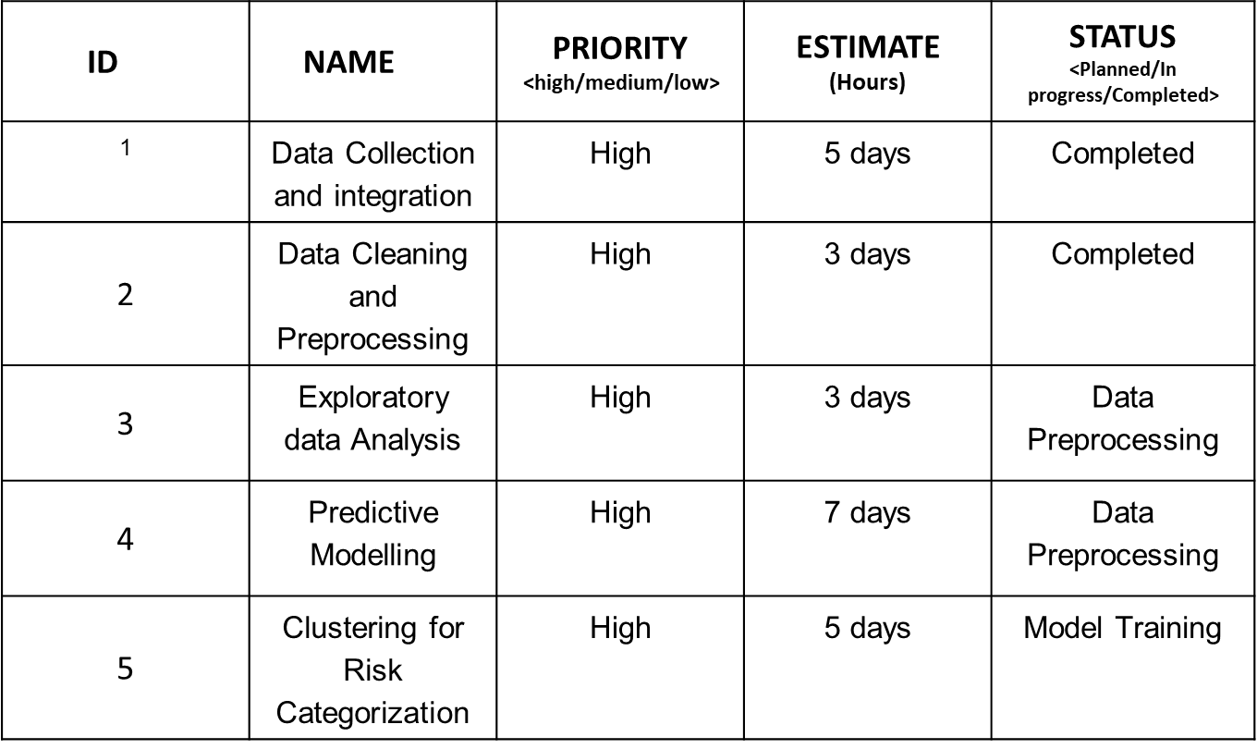
PRODUCT BACKLOG

Slide 12
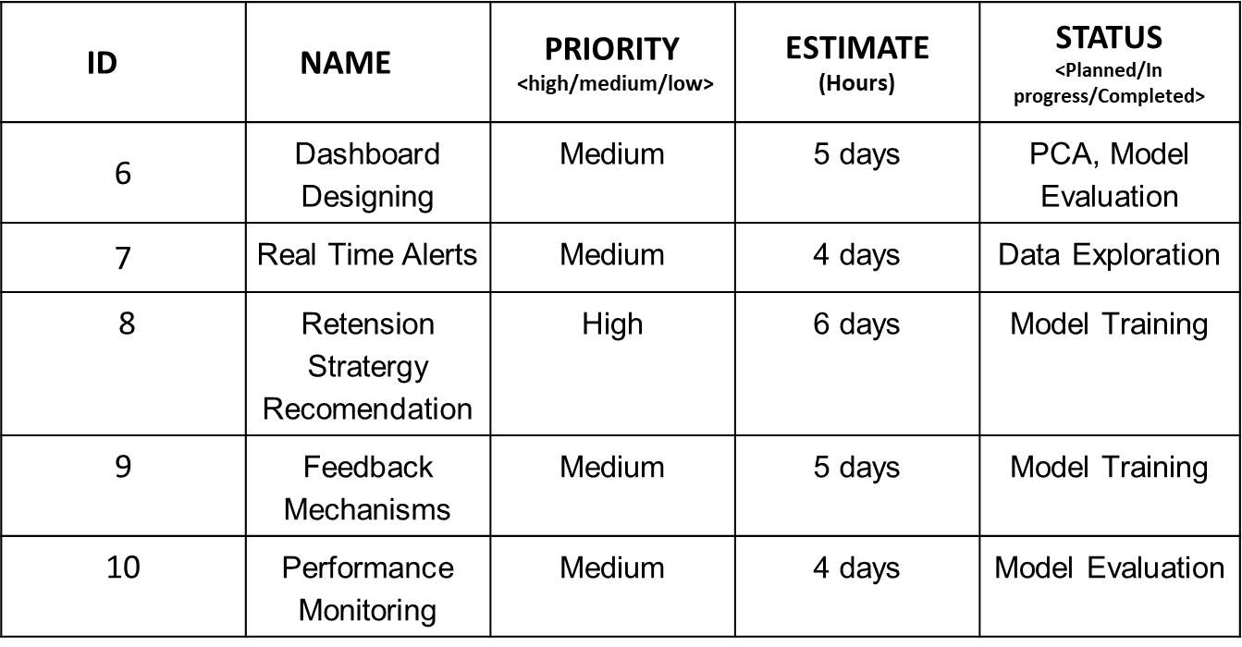

Slide 13
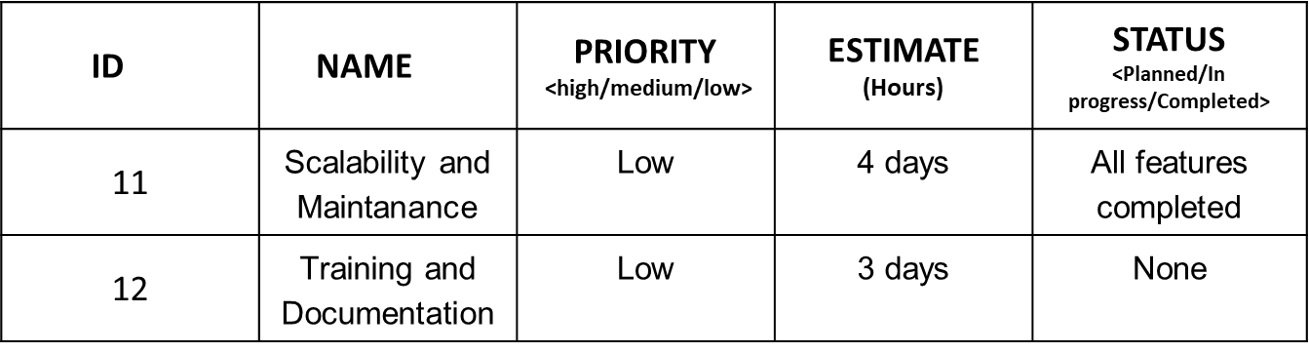

Slide 14
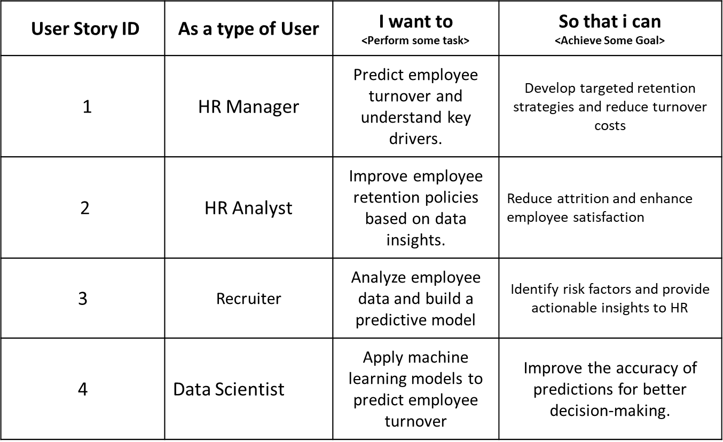
USER STORY

Slide 15
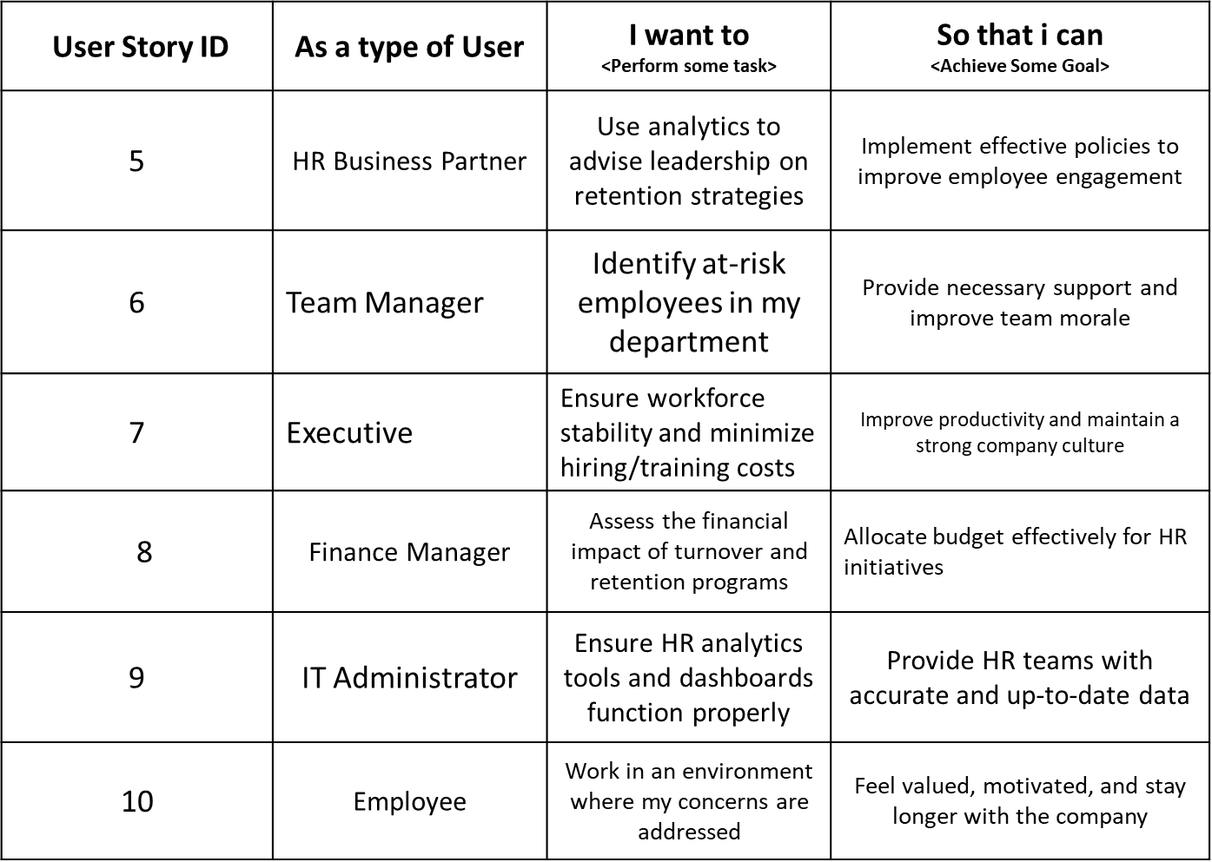
USER STORY

Slide 16
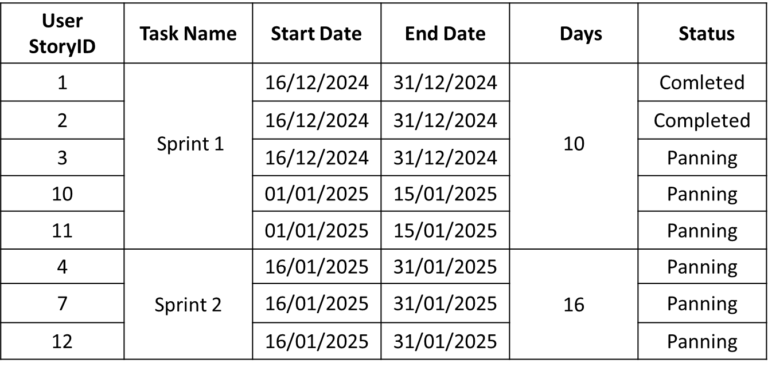
PROJECT PLAN

Slide 17
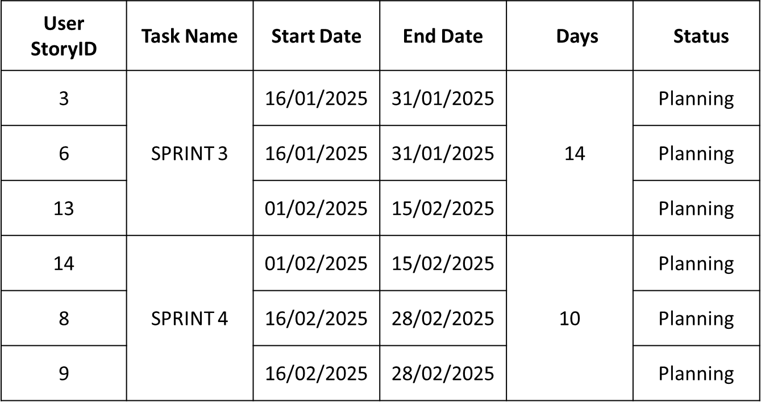
PROJECT PLAN

Slide 18
THANK YOU

